Slide 1
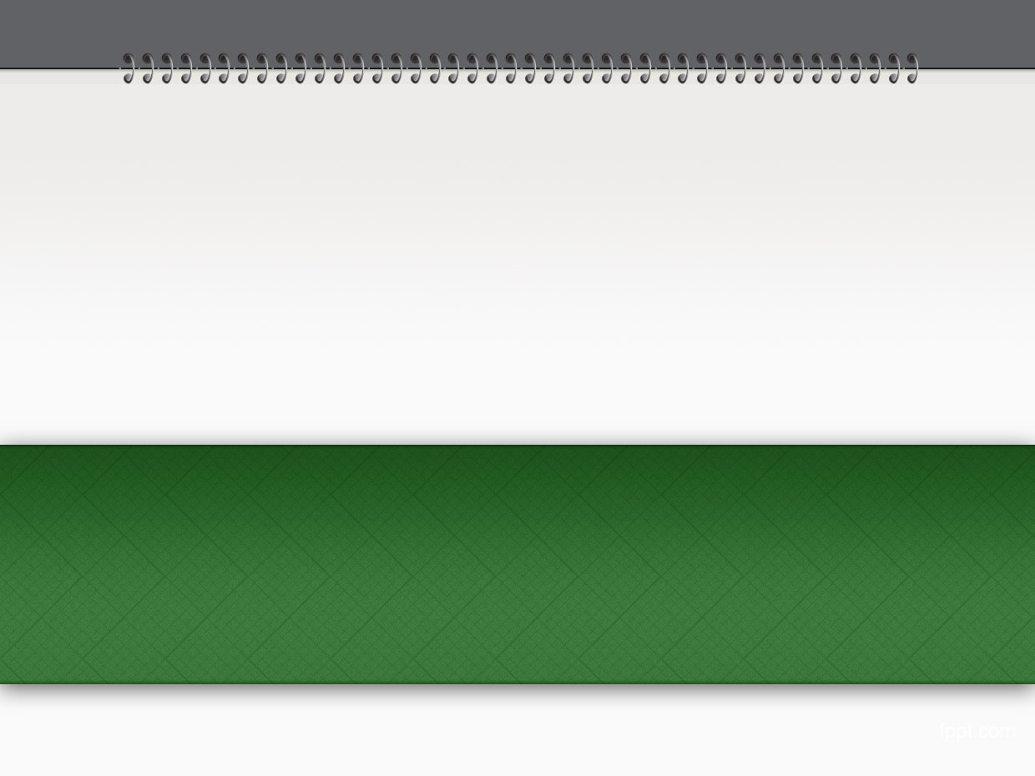


http://pingo.edu.vn/khoa-hoc-php-can-ban/
PHP Basics - Statements
Web Applications in Hatch
Tuan Duong
http://pingo.edu.vn/tuan-duong/

Slide 2
Contents
Conditional Statements
If
If…else
Else…if
Switch

Slide 3
Contents
Looping Statements
The While Loop
The Do… While Loop
The For Loop
The Foreach Loop

Slide 4
Conditional Statements
Conditional statements are the set of commands used to perform different actions based on different conditions.
We have the following conditional statements
If
If else
Else if
Switch

Slide 5
If statement
If structure is used for conditional execution of code segment
Syntax
If (expr) {
// Statements
}

Slide 6
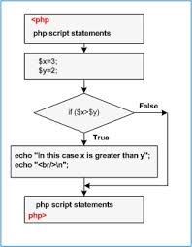
If statement

Slide 7
Example
<?php
$var1 = 10;
$var2 = 1;
if ($var1 > $var2) {
echo "var1 is bigger than var2";
}
?>
In above example, only if the condition ($var1 > $var2) is true, the message “var1 is bigger than var2” is displayed.

Slide 8
Else statement
The conditional statement “else” is used as extension of “if” statement. If the condition fails then it executes another statements under the “else” condition
Syntax
If (expr) { // true
// Statements
} else { //false
// Statements
}

Slide 9
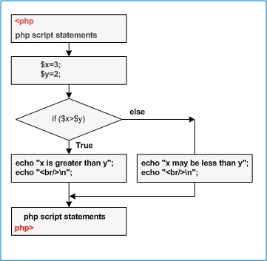
Else statement

Slide 10
Example
<?php
$var1 = 1;
$var2 = 10;
if ($var1 > $var2) {
echo "var1 is bigger than var2";
} else {
echo "var2 is bigger than or equal to var1";
}
?>

Slide 11
Result
Result: var2 is bigger than var1
In the above example, if the condition (“$var1 > $var2”) is true, then the message “var1 is bigger than var2” is displayed, else the message “var2 is bigger than var1” is displayed.
Question: What is the result if $var1 = $var2?

Slide 12
Else if statement
Else if statement is used as extension of “If” structure. If the condition fails then it checks another “If” condition to execute the code segment under the “else if” statement.
Syntax
If (expr1) { // true
// Statements
} else if (expr2) { //true
// Statements
} else { // false
// Statements
}
Based on the failure of “expr1” condition, “expr2” is checked and then statements are executed.

Slide 13
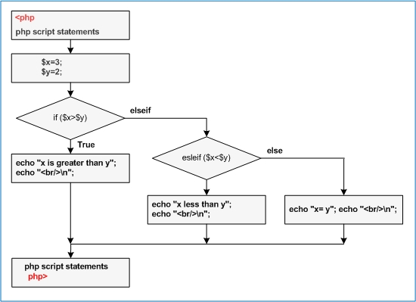
Else if statement

Slide 14
Example
<?php
$var1 = 10;
$var2 = 10;
if ($var1 > $var2) {
echo "var1 is bigger than var2";
} else if ($var1 == $var2) {
echo "var1 is equal to var2";
} else {
echo "var1 is smaller than var2";
}
?>

Slide 15
Result
Result: var1 is equal to var2
In the above example, if the condition (“$var1 > $var2”) is true, then the message “var1 is bigger than var2” is displayed, else the condition in the “else if” that is “$var1 == $var2” is evaluated if it is true, the message “var1 is equal to var2” is displayed, otherwise “var1 is smaller than var2” is displayed.
We can use multiple of “else if” blocks.

Slide 16
Switch statement
The Switch case statement is used to compare a variable or expression to different values based on which a set of code is executed.

Slide 17
Syntax
switch (variable or expression) {
case (value 0):
// Statements 0
case (value1):
// Statements 1
…
case (value n):
// Statements n
default:
// Statements default
}

Slide 18
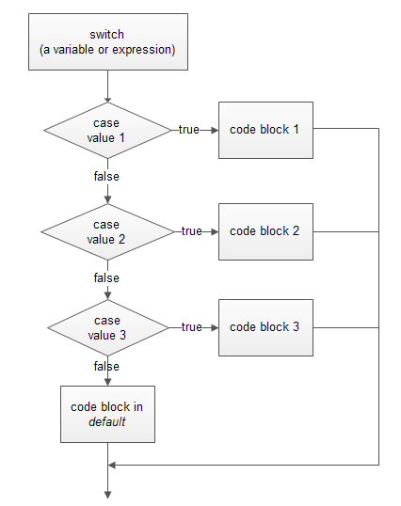
Switch statement

Slide 19
Example
<?php
$var = 10;
switch ($var) {
case 1:
echo "Value of var is 1";
break;
case 2:
echo "Value of var is 2";
break;
case 10:
echo "Value of var is 10";
break;
default:
echo ”I don’t know";
break;
}
?>

Slide 20
Result
Result: Value of var is 10
In the above example, based on the value of $var, the messages are displayed of that particular case which matches. The default case accepts anything not matched by other cases.

Slide 21
Looping Statements
Loops execute a block of code a specified number of times, or while a specified condition is true.
In PHP we have the following looping statements
The While Loop
The Do… While Loop
The For Loop
The Foreach Loop
Break and Continue Statements

Slide 22
The While Loop
While structure is another type of loop statements, where the condition is checked at first, the iteration will not stop even if the value changes while executing statements.
Syntax
while (condition) {
// Statements
}

Slide 23
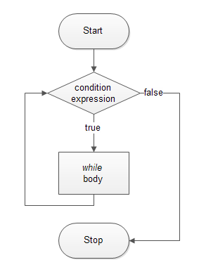
The While Loop

Slide 24
Example
<?php
$index = 0;
while ($index <= 10) {
echo "The number is " . $index . " <br />";
$index++;
}
?>

Slide 25
The Do… While Loop
Do While statement is same as the While statement, the only difference is that it evaluates the expression at the end. Meaning the loop statement will be executed one time at first before the loop condition is checked.
Syntax
do {
// Statements
} while (condition);

Slide 26
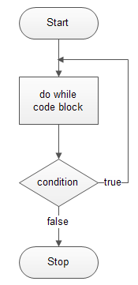
The Do… While Loop

Slide 27
Example
<?php
$index = 0;
do {
echo "The number is " . $index . " <br />";
$index++;
} while ($index <= 10);
?>

Slide 28
The For Loop
The For loop is used when you know in advance how many times the script should run.
Syntax
for (initialization; condition; increment) {
// Statements
}

Slide 29
The For Loop
for (initialization; condition; increment) {
// Statements
}
The For loop statement take three expressions inside its parentheses, separated by semi-colons (;). When the For loop executes, the following occurs:
The initializing expression is executed. This expression usually initializes one or more loop counters, but the syntax allows an expression of any degree of complexity.
The condition expression is evaluated. If the condition is true, the loop statements are executed. If the value of condition is false, the For loop terminates.
The update expression increment executes.
The statements execute, and control returns to step 2.

Slide 30
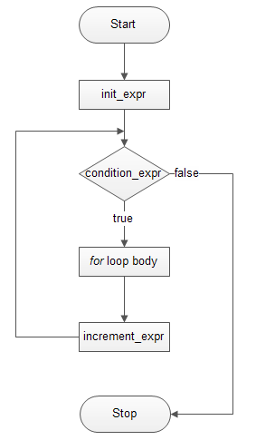
The For Loop

Slide 31
Example
<?php
for ($index = 0; $index <= 10; $index++) {
echo "The number is " . $index . " <br />";
}
?>

Slide 32
The Foreach Loop
The Foreach structure is a loop structure used for arrays.
Syntax
foreach (array as value) {
// Statements
}
foreach (array as key => value) {
// Statements
}

Slide 33
Example
<?php
$numberArray = array(0, 1, 2, 3, 4, 5, 6, 7, 8, 9);
foreach ($numberArray as $value) {
echo "The number is " . $value . " <br />";
}
$emailArray = array("bacduong@gmail.com", "john.smith@gmail.com", "tom.nguyen@gmail.com");
foreach ($emailArray as $key => $email) {
echo "The email number " . $key . " is " . $email . " <br />";
}
?>

Slide 34
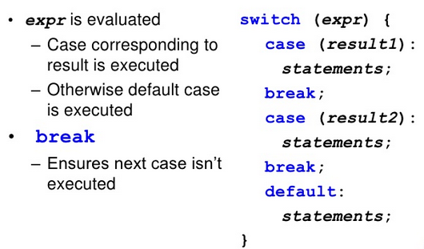
Switch

Slide 35

Switch

Slide 36
The Break Statement
Break ends the execution of the for, for each, while, do-while or switch statement.
Syntax
break (Optional numeric argument);

Slide 37
Example
<?php
$index = 0;
while (++$index) {
switch ($index) {
case 5:
echo "At " . $index . "<br />";
break 1;
case 10:
echo "At " . $index . "<br />";
break 2;
default:
break;
}
}
?>

Slide 38
The Continue Statement
“Continue” is used to skip the current loop iteration and continue with the next iteration of the loop. But the “Break” is used to exit from the whole loop.
Syntax
continue (Optional numeric argument);

Slide 39
Example
<?php
for ($index = 0; $index <= 10; ++$index) {
if ($index == 2) {
continue;
}
echo "Current index is $index <br />";
}
?>

Slide 40
PHP Basics - Statements

